Slide 1


INTERNSHIP REPORT
Name: J Sai Chandu
Register Number: 192211216

Slide 2


About the Organization.
COMPANY OVERVIEW
SkillEntrix is a company startup and private limited company focused on bridging the gap between education and industry, providing students with hands-on experience in real-world projects.
The department I worked in.
Web Development

Slide 3

INTERNSHIP OBJECTIVES
Hoped to achieve during the internship.
Primary objectives of internship..
Gain industry-level exposure in web development.
Enhance coding and problem-solving skills.
Collaborate on real-time projects using HTML, PHP, MySQL program.
Understand project development lifecycle.
Build a functional and impactful web application.

Slide 4

WORK RESPONSIBILITIES
Projects I worked on or assisted with.
ProTeam: Team management portal
My main tasks and responsibilities.
Designing and developing student profile creation and
interest-tagging features.
Implementing intelligent match-making logic.
Creating real-time messaging features.
Collaborating with the tech team using technologies like
HTML, PHP, MySQL.

Slide 5
Challenges I faced during my Internship
Security and Data privacy compliance.
Maintaining Audit trails and system logs.
How I addressed or overcame
them.
Participated in internal team discussions.
Studied documentation and sought help from mentors.
Practiced solving related problems to improve understanding.
CHALLENGES AND SOLUTIONS

Slide 6
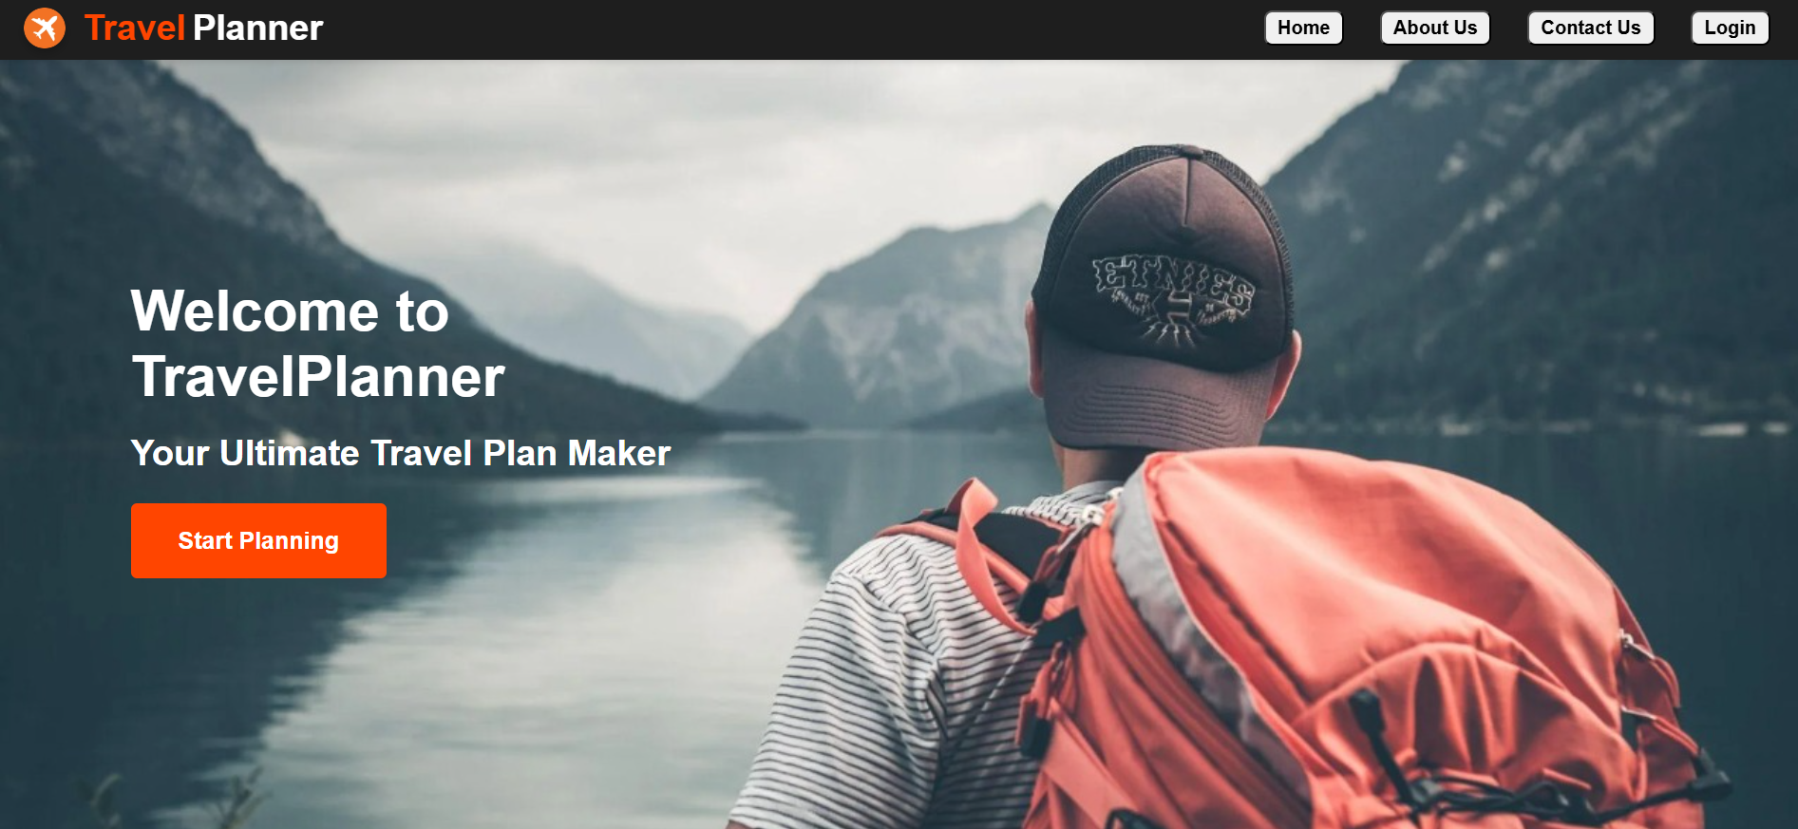
SKILLS GAINED AND KNOWLEDGE ACQUIRED
Tools, software, or methodologies I learned.
The professional and personal skills I developed.
Pictures if any..
Team collaboration
Time management
Debugging and optimization
HTML, MySQL, Visual studio, postman
Git & GitHub for version control

Slide 7
CONTRIBUTION TO THE ORGANIZATION
How my work added value to the organization.
Developed critical features in the ProTeam.
Helped enhance user experience through
Handling academic projects.
Feedback received from my supervisor or team.
Appreciated for commitment, proactiveness, and technical contribution.

Slide 8
Summarization of Internship Experience.
The internship was a valuable learning experience that helped me improve my Web development skills and apply them in a meaningful project.
CONCLUSION
Reflect on how the internship aligned with my career goals.
Strongly aligned with my goal of becoming a Web developer and contributing to impactful tech solutions.

Slide 9
ATTACHMENTS
Project Completion Certificate
Project Title: Travel Planner
Completion Date: 20th february 2026
Description: Developed a travel planner web development streamline student collaboration for academic and technical projects.
Key features included user registration, project posting, skill and interest tagging, intelligent team matching, and a real-time chat module for seamless communication.
Internship Completion Certificate Issued by: SKILLENTRIX TECHNOLOGIES
Duration: 20/12/2025 to 20/02/2026
Highlights: Successful completion of a web
Development Internship. Worked on real-time applications and technologies HTML, MySQL, Visual studio, PHP, etc..

Slide 10
THANK YOU

